Slide 1
DSA Capstone Project
”PAKET OJEK ONLINE”
GROUP 12
Yustinus Kunta Wibisana
Shelby Marsa Istiqomah
Wahyu Sejati Roso
Rizaldy A.K. Utomo

Slide 2
Overview
Business Understanding
Data Understanding
Data Preparation
Modelling
Evaluation
Deployment

Slide 3
Business Understanding
Data Understanding
Data Preparation
Modelling
Evaluation
Deployment

Slide 4
PROBLEM STATEMENT
Saat ini Telkomsel telah memiliki paket combo khusus ojek online (Gojek & Grab) dengan deskripsi product sebagai berikut :
Price : IDR 75.000 (include tax)
Voice Onnet : Unlimited
Voice Offnet : 200 Mins
SMS Onnet : 500 SMS
Data All Net : 15 GB
Paket combo tersebut hanya ditujukan untuk whitelisted msisdn. Jumlah whitelist paket combo tersebut per Oktober 2019 adalah sebanyak 1.74 juta pelanggan dengan monthly take up rate mencapai 32% atau 559K

Slide 5
Business Understanding – Business Case
Background
Paket Ojek Online (COMBO) Telkomsel offering for multiple services for Grab and GoJek
Project Plan
We aim for 2 month project and using agile methodology of development
Build supervised model that can predict among whitelisted customer, which one will buy combo package for ojek online.
Segment customer using clustering method, identify each cluster characteristic and which one is most likely will purchase the specified package.
Among each cluster, develop subsegment group using ARPU and determine which subsegment group will the specified package will be offered.
Business Objectives
Tools and Techniques
We use jupyter notebook and python language for training models
We use tableau for data visualization
Business Success Criteria
Model performed with at least AUC above 70% - F1 score
Increase takers from 32% into 50%

Slide 6
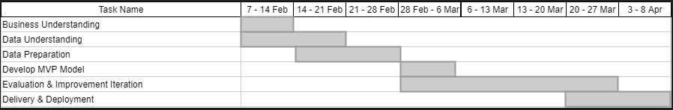
Timeline

Slide 7
Business Understanding
Data Understanding
Data Preparation
Modelling
Evaluation
Deployment

Slide 8
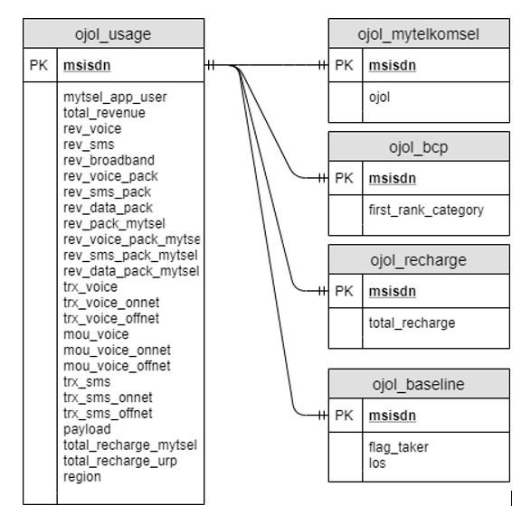
Data Source
Server Address : 10.250.191.80
Username/pass : group12 / Tsel#gr12
mysql -u group12 -p -h 127.0.0.1
password : passwd#tsel12!
Table Used:
Ojol_usage
Ojol_mytelkomsel
Ojol_bcp
Ojol_recharge
Ojol_baseline

Slide 9
DATA DICTIONARY (1/2)
msisdn : nomor sim card
flag_taker : keterangan taker ( 1 = taker, 0 = non taker)
LoS : Length of Stay atau umur simcard (hari)
first_rank_category : Apps dominan yang dipakai (peringkat 1)
mytsel_app_user : keterangan sebagai pengguna MyTelkomsel (1 = user MyTelkomsel, 0 = non pengguna MyTelkomsel)
total_revenue : revenue keseluruhan dari semua layanan pada simcard tersebut selama sebulan (rupiah)
rev_voice : revenue voice dari simcard tersebut selama sebulan (rupiah)
rev_sms : revenue sms dari simcard tersebut selama sebulan (rupiah)
rev_broadband : revenue data dari simcard tersebut selama sebulan (rupiah)
rev_voice_pack : revenue khusus paket voice dari simcard tersebut selama sebulan (rupiah)
rev_sms_pack : revenue khusus paket sms dari simcard tersebut selama sebulan (rupiah)
rev_data_pack : revenue khusus paket data dari simcard tersebut selama sebulan (rupiah)
rev_pack_mytsel : revenue paket, pembelian dari MyTelkomsel (rupiah)
rev_voice_pack_mytsel : revenue paket voice, pembelian dari MyTelkomsel (rupiah)
rev_sms_pack_mytsel : revenue paket sms, pembelian dari MyTelkomsel (rupiah)
rev_data_pack_mytsel : revenue paket data, pembelian dari MyTelkomsel (rupiah)
trx_voice : jumlah transaksi panggilan
trx_voice_onnet : jumlah transaksi panggilan onnet - ke sesama operator

Slide 10
DATA DICTIONARY (2/2)
Trx_voice_onnet : jumlah transaksi panggilan onnet - ke sesama operator
trx_voice_offnet : jumlah transaksi panggilan offnet - ke luar operator
mou_voice : durasi penggunaan layanan voice (detik)
mou_voice_onnet : durasi penggunaan layanan voice onnet - ke sesama operator (detik)
mou_voice_offnet : durasi penggunaan layanan voice offnet - ke luar operator (detik)
trx_sms : jumlah transaksi sms
trx_sms_onnet : jumlah transaksi sms onnet - ke sesama operator
trx_sms_offnet : jumlah transaksi sms offnet - ke luar operator
payload : quota penggunaan layanan data (byte)
total_recharge_mytsel : total isi ulang pulsa selama sebulan melalui aplikasi MyTelkomsel (rupiah)
total_recharge_URP : total isi ulang pulsa selama sebulan melalui Universal Recharge Platform (rupiah)
region : dominan regional simcard tersebut aktif
total_recharge : total isi ulang pulsa selama sebulan melalui aplikasi MyTelkomsel (rupiah)
login : keterangan pernah login di MyTelkomsel (Y = pernah login, N = tidak pernah login)

Slide 11
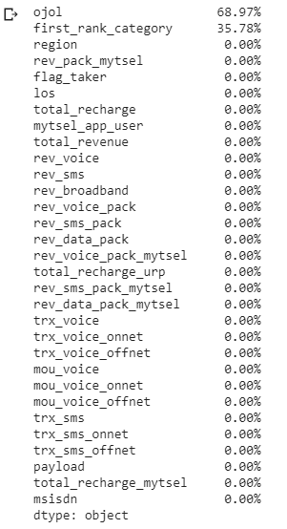
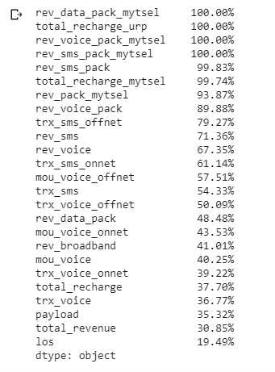
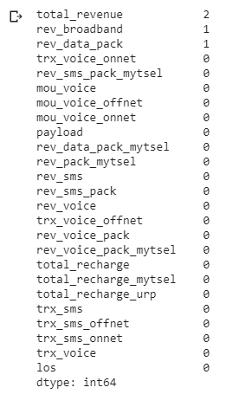
Missing Values (NaN)
Zero Values
Negative Values

Slide 12
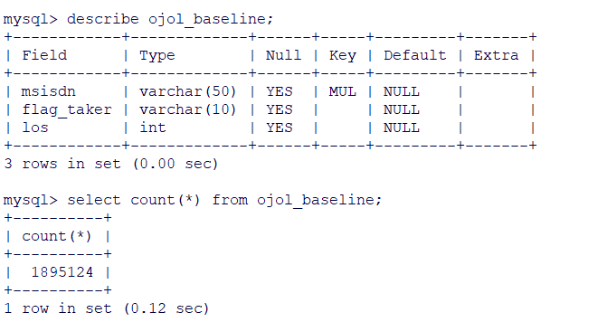
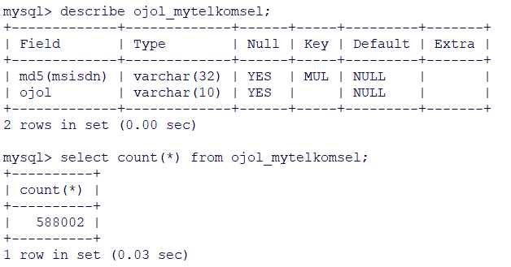
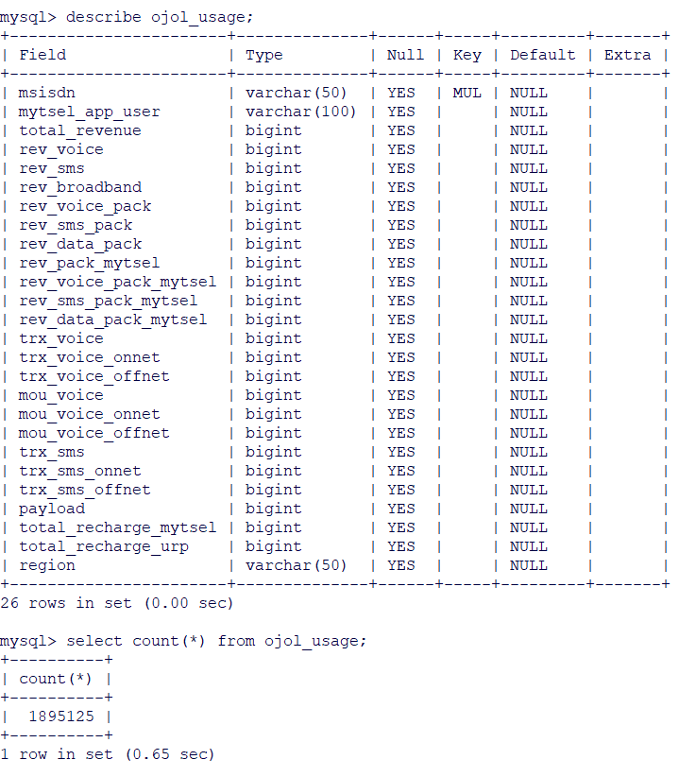
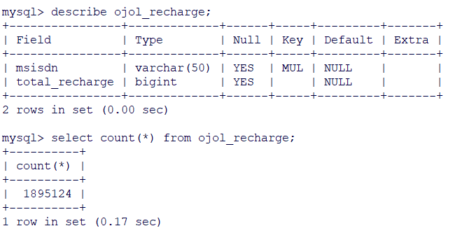
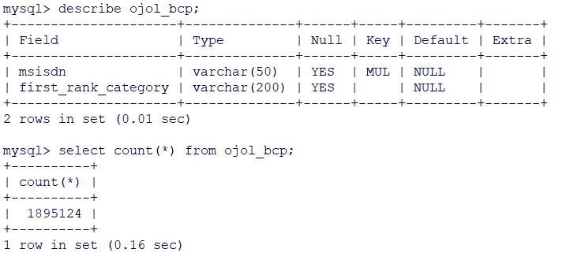
01
DATA DESCRIPTION
Ojol_baseline
Ojol_mytelkomsel
Ojol_usage
Ojol_recharge
Ojol_bcp
Number of MSISDN : 1.895.124
Master table : ojol_baseline (has flag_taker)
Join ojol_baseline with other tables using msisdn -> create table : ojol_dim

Slide 13
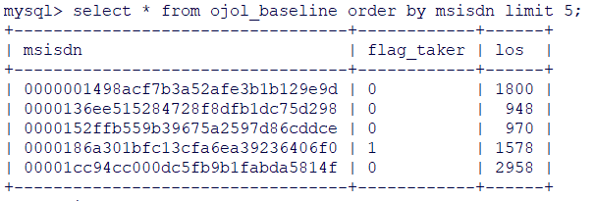
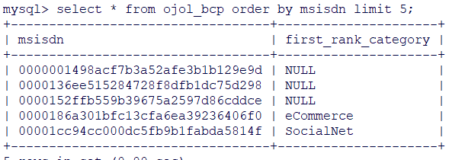
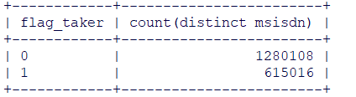
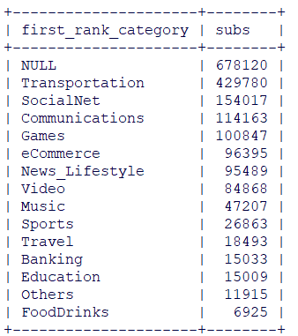
Ojol_baseline
Ojol_bcp
There are 14 apps categories (exclude null)
Most used apps category as first rank apps is Transportation then SocialNet,Communication, Games.
This can be used to enhanced product offering by bundle package with other apps.
Flag Taker : 0 (non-taker) and 1 (taker)
Taker only 32.5%

Slide 14
01
DATA DESCRIPTION
Number of taker subs only 32.5% from total subs, but generate higher revenue.
Taker subs generate ARPU 125k per month while Non-Taker ARPU only 95k.
Taker’s revenue mostly contributed from Revenue Broadband with ARPU Broadband up to 115k per month (92% from its total ARPU)
Non-Taker’s voice and sms revenue higher than voice and sms revenue of Taker’s.
Taker’s payload is 2x higher than Non-Taker’s, but the average payload per user only 21MB.
ARPU package mytsel Non-Taker’s is 2x higher than Taker. And Non-Takers average recharge is higher than Taker’s. It shows that NonTaker utilize mytsel apps more than Takers.

Slide 15
01
DATA STATISTICS
IQR is used to find the distribution of data and detect outliers.
From data’s statistics, there’s huge gap between max value and IQR which shows in every features have outliers.
These outliers will be found using IQR as threshold for each features.
There are 4 features with no value and will be removed from machine learning process.

Slide 16
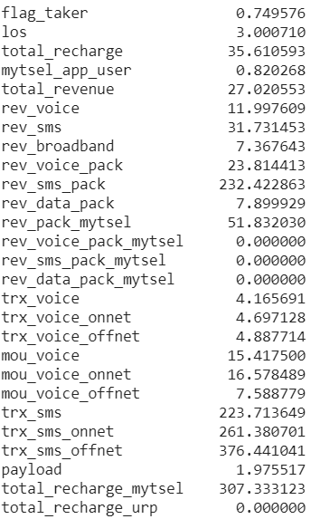
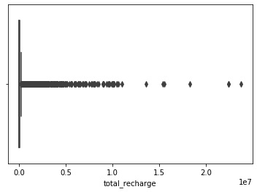
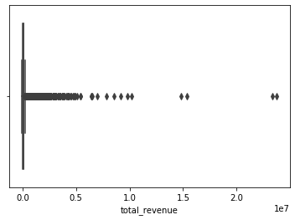
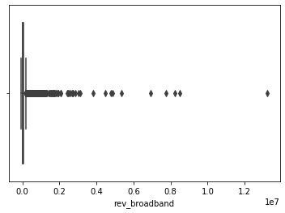
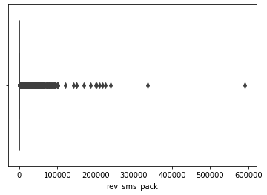
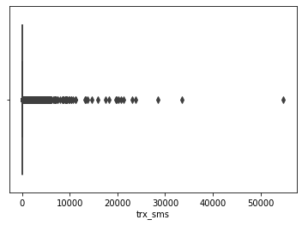
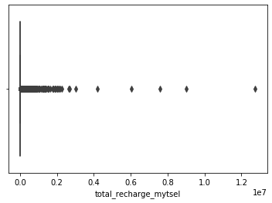
01
DATA OUTLIERS
Skewness used to show distribution of data, which explains the extent to which the data is normally distributed.
Ideally, the skewness value should be between -1 and +1, and any major deviation from this range indicates the presence of extreme values/
This data shows that every features has a right-skewed distribution, indicating the presence of extreme higher values, specially sms features and total_recharge_mytsel.

Slide 17
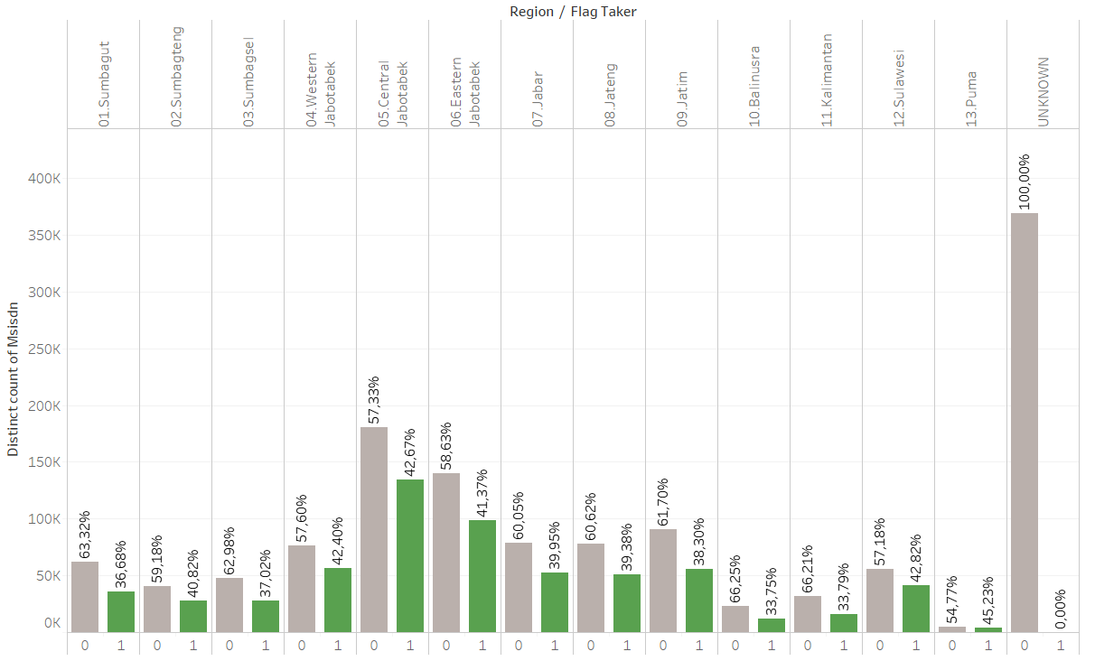
TAKER PER REGION

Slide 18
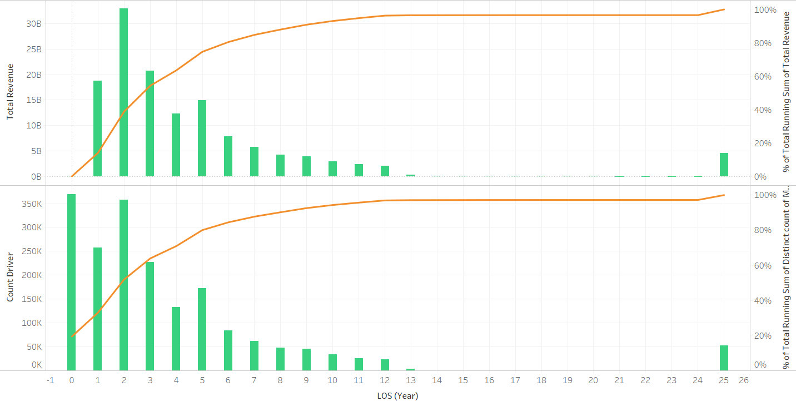
Revenue and Subs Count Distribution per LOS (Year)

Slide 19
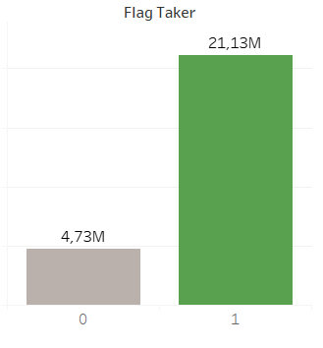
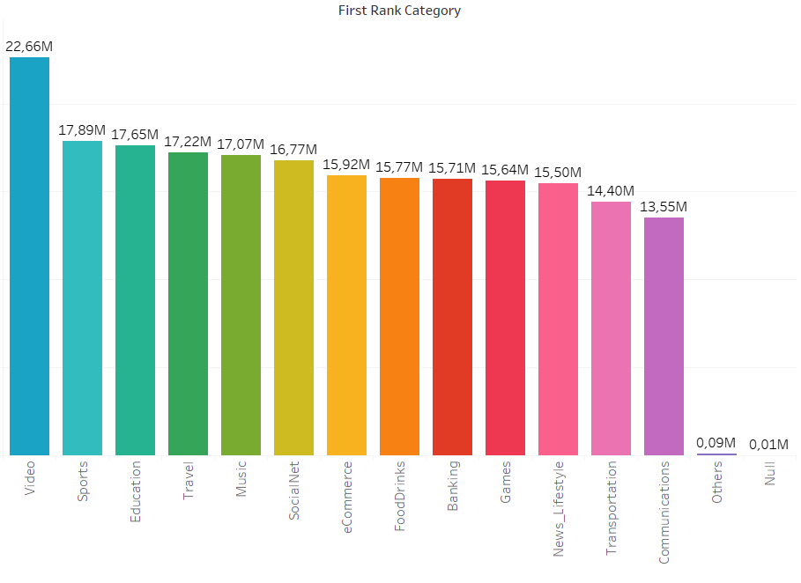
Payload
Average Payload/Group
Average Payload/Category

Slide 20
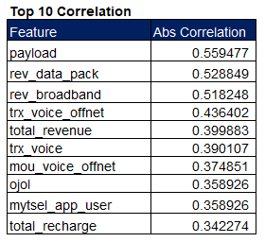
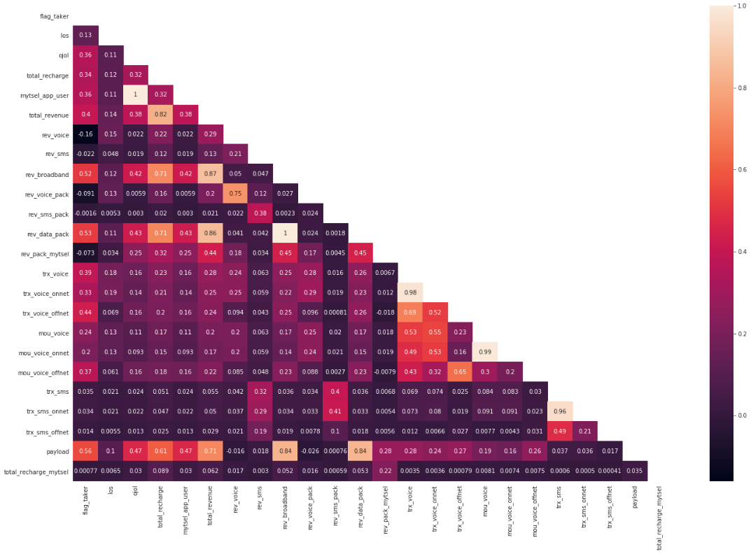
Feature Correlation

Slide 21
Question
- Konfirmasi ke BU -> target monthly take up rate nya berapa
- Perhatikan msisdn yang SA -> yang taker tapi belum ada payload dan trx cuma satu
- kolom mytsel_apps itu apakah msisdn yang pakai mytsel?
- Apakah bisa ditambahkan paket lain yang diambil oleh seluruh msisdn sebagai perbandingan paket ojol dan paket lain, paket mana yang paling banyak diminati.
- Cek juga harga paket ojol kompetitor sebagai komparasi harga paket ojol telkomsel
- Apakah bisa ditambahkan flag Grab Driver/Gojek Driver?
- rev_data_pack dan payload bisa dibreakdown lagi kah payloadnya berasal dari penggunaan aplikasi apa saja

Slide 22

Thank you!

